Slide 1







YUKTI Innovation Challenge 2023
Institution’s Innovation Council (IIC),
Ministry of Education’s Innovation Cell
Submission of Assignments 1-5 for 1st Stage Evaluation
Proto ID:
IIC Institute Name:
Team Lead Name:
Theme/Sector of Focus:
Mentor Name:
Team Members:
Innovation Title:

Slide 2
Assignment 1: Problem Framing/Statement Canvas Preparation and Submission of a Problem Statement Canvas Sheet for Validation of your Idea/Prototype/Innovation Find few Sample Problem Statement/Framing Canvas copy for Reference and Blank Formats for Fill up and Upload the same (jpg or pdf) in the YUKTI Portal.
Please refer the example and format of Problem Statement Canvas provided at https://www.metabeta.com/blog/process/problem-statement-canvas/. Alternatively can refer the Problem Framing Canvas at https://miro.com/miroverse/problem-framing-canvas-1/

Slide 3
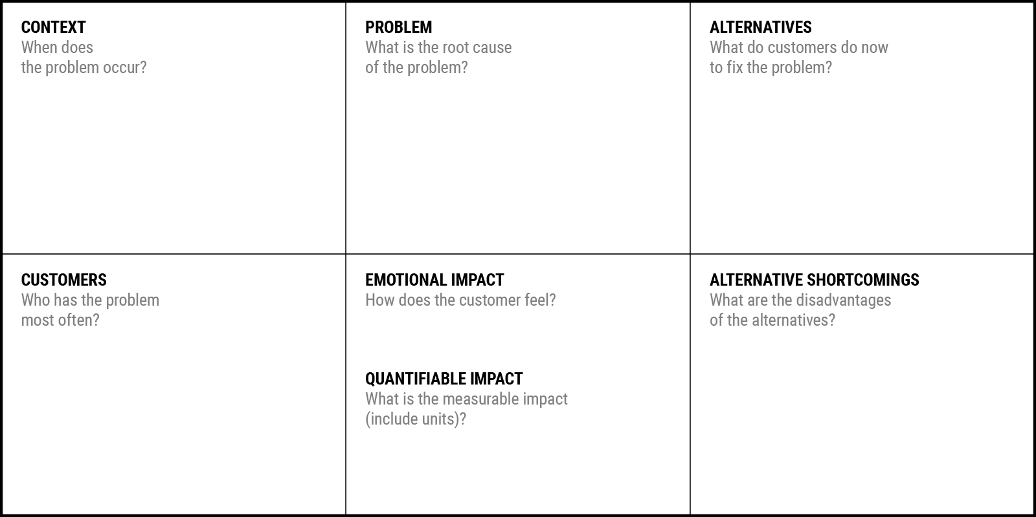
Problem Statement Canvas
YUKTI Proto ID:
Idea/Innovation Title:
Date of Submission:
Who is your Customer Segment:
Prepared By:
Contact No:
Your Answer:
Your Answer:
Your Answer:
Your Answer:
Your Answer:
Your Answer:
Your Answer:

Slide 4
Assignment 2: Empathy Map/Opportunity Canvas Preparation and Submission of an Empathy Map/ Opportunity Canvas Sheet for Validation of your Prototype/Innovation Find few Sample empathy canvas copy for Reference and a Blank Format for Fill up and Upload the same (jpg or pdf) in the YUKTI Portal.
Complete Guidance of Preparing Empathy Canvas with Templet Available at https://miro.com/miroverse/empathy-map-canvas-1/
Opportunity Canvas at

Slide 5
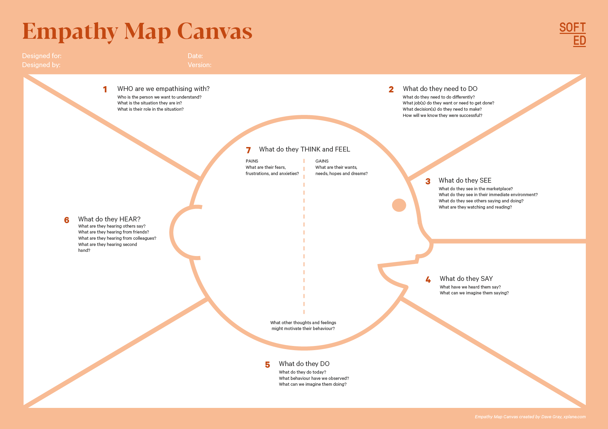
Who is your Customer Segment:
Idea/Innovation Title:
Designed By:
Date of Submission:
YUKTI Proto ID:
Your Answer:
Your Answer:
Your Answer:
Your Answer:
Your Answer:
Your Answer:
Your Answer:
Your Answer:
Your Answer:

Slide 6
Assignment 3: Business Model Canvas Preparation and Submission of an Business Model Canvas Sheet for Business Opportunity Validation of your Prototype/Innovation Find few Sample Business Model Validation copy for Reference and a Blank Framework for Fill up and Upload of the same (jpg or pdf) in the YUKTI Portal.

Slide 7
Idea/Innovation Title:
YUKTI Proto ID:

Slide 8
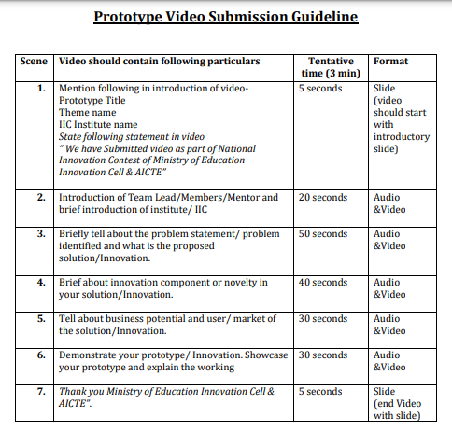
Assignment 4: Recent Images of Prototype/Innovation
Place at least two –three recent images of your product/innovation & Place the URL of maximum 3 minutes video on your product/innovation. Refer video preparation guideline
Note:
If video contains the IP component then video may be uploaded in the google drive and access shall be given to yukti@aicte-india.org
Due to ease of accessibility, the video may be uploaded on YouTube and video link should be provided.
Only provide video URL/Link and no video should be sent in email to MIC

Slide 10
Assignment 5: Submit Brief Presentation on your Innovation and Business Opportunity Plan

Slide 11
Presentation Format

Slide 12
1. The Overview
Create a very high-level overview of your product or service
Who are you and why you're here?
Keep it short and sweet
Don’t put too much text on the slide
Create a hook
LEARN NOW

Slide 13
2. The Problem
What problem are you trying to solve? Is it really a problem?
Description of customer pain points
What kind of person/customer is this product for? - Persona
How the innovation/startup solves it - concept & key elements.
Brief tech involved
LEARN NOW

Slide 14
3.The Solution
Describe how are you solving the problem
What the Solution
Why it’s compelling
Include explainer videos, images, demos, product screenshots
LEARN NOW

Slide 15
4. The Product/Service
Describe how are you solving the problem
Include explainer videos, demos, product screenshots
Include PoCs.Include testimonials of actual customers, if any.
Value Proposition of product/service
Benefits/Impact its creating
LEARN NOW

Slide 16
5. Market & Opportunity
Describe/Highlight the size of your target market
Total Addressable Market
Serviceable Addressable Market (SAM)
Target Market - The portion of SAM that you can capture
Provide Primary/Secondary Research Data
LEARN NOW

Slide 17
6. The Technology/Innovation
Describe the technologies you are using to solve the problem
Stage of the development of solution
State/Stage the Technology Readiness Level (TRL)
Highlight the Intellectual Property (IP) component
Innovation & Uniqueness
Road Map for going forward
LEARN NOW

Slide 18
7. Competitive Landscape
What are the alternative solutions available in the market?
Mention Potential Competitors
Mention Competitive Advantage of your Product over others
Tell about what sets you apart from competitors
Highlight Barriers to entry – Key partnerships, IP
What are Opportunities for collaboration and co-creation
LEARN NOW

Slide 19
8. Business Model
What is your revenue model?
Clearly and concisely explain how you generate Money: Source of Revenue
Investors want to know that you have a viable business model in place even if you aren’t currently making a profit
LEARN NOW

Slide 20
9 Traction
Customer Validation
Mention any business traction you received so far for your innovation/product/service
Talk about Key Performance Indicators (KPIs)starting from product development to product launch and growth of business
Month on month growth rate
Pre orders
Letter of intent
Beta sign ups
Key Partnerships/Licenses
LEARN NOW

Slide 21
10. Resource Mobilization Plan
What is your Resource Mobilization Strategy and What you have done so far?
Production Plan?
Resource Requirement – Human & Technology & Infrastructure/
facility
Financial/Fund Raised/received from Alternatives Sources: Govt. Grant, Friends, Bootstrapping, Bank loans etc.
LEARN NOW

Slide 22
11. Way forward Strategy
What is your implementation strategy in short-term, midterm and long-term?
Short term if any?
For example; Joining an Incubation unit, Forming Startup, Technology Transfer etc.
Mid term if any?
Launch of Product, Market enrollment, Dilution of Founders Share/Equity, incubation, credit/loan etc.
Long term if any?
For On-boarding Angel and VC partner on equity or debt funding mode etc.
IPO, Sale out, M&A etc.
LEARN NOW

Slide 23
12. The Team
Show the people behind the idea and briefly describe their role
Founders
Key team members
Key advisors/mentors
Team member’s history
Educational/Industry backgrounds and expertise
Describe their specific role in the company
Explain the unique value each person brings to the startup
Talk about their passion for the project and why they decided to work for a startup
LEARN NOW

Slide 24
13. Contact
Leave your contact details and let people know how to reach you quickly
2 phone nos.
Email id
LEARN NOW

Slide 25
Thankyou

